Slide 1

STUDIES OF DEVELOPER BEHAVIOUR
Fadhluddin bin Sahlan 1817445
Test 2

Slide 2
Summary
This project is investigating the behaviour of developers around the world and in Malaysia using tools like Pyspark.

Slide 3
Background
Developer is one of the new career chosen by people nowadays due to the expansion of technology IR 4.0. Many people choose to become a developer but still these people not fulfil the capacity of developers needed nowadays. However, some questions need to be answered by this future developer whether their ambition is suitable with their personality and such.

Slide 4
Data Science Questions
What is the summary of years that developers do coding?
What is the satisfaction of the developers in their career?
How many developer that answer the survey are coming from Malaysia?
What is the summary of years that developers from Malaysia do coding?
Do you consider Malaysian Developer as overwork?
What is the most Programming Language people in Malaysia most worked with?

Slide 5
Methodology
Only required Data cleaning and Data Transformation is done to the datasets.
Using Pyspark for analysis
Using Pandas and Matplotlib for Visualization

Slide 6
Results & Visualization

Slide 7
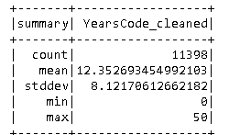
What is the summary of years that developers do coding?
It appears that the mean of years that developer do coding is about 12.35 years while maximum years coders experience is 50 years. This data is based on 11 398 individual that responds to the survey

Slide 8
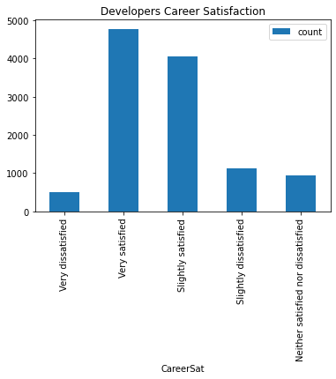
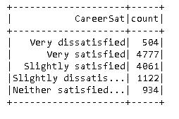
What is the satisfaction of the developers in their career?

Slide 9
How many developer that answer the survey are coming from Malaysia?
42 respondents

Slide 10
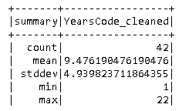
What is the summary of years that developers from Malaysia do coding
The mean of experience in years for developers in Malaysia do coding is 9.48 years while the maximum years of experience is 22 years. This is based on the data collected from 42 respondents.

Slide 11
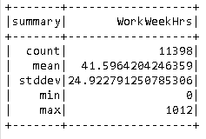
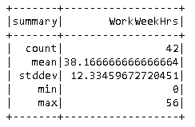
Do you consider Malaysian Developer as overwork?
Malaysian Developer is not overwork since the mean of working hours weekly is lower than the mean of world
Summary for World
Summary for Malaysia

Slide 12
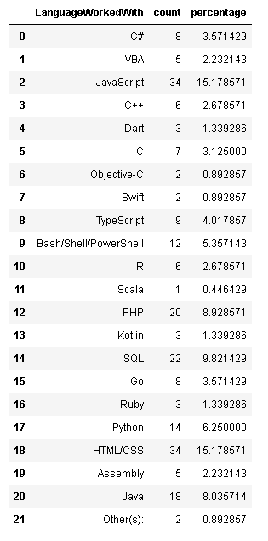
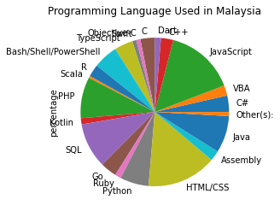
What is the most Programming Language people in Malaysia most worked with?
Answer: THE MOST FAMOUS PROGRAMMING LANGUAGE IN MALAYSIA ARE HTML/CSS AND JAVASCRIPT.

